Slide 1
More about Rust
Mehraj Ud Din Shah Peerzada

Slide 2
Contents of this template
You can delete this slide when you’re done editing the presentation
Fonts | To view this template correctly in PowerPoint, download and install the fonts we used
Used and alternative resources | An assortment of graphic resources that are suitable for use in this presentation
Thanks slide | You must keep it so that proper credits for our design are given
Colors | All the colors used in this presentation
Icons and infographic resources | These can be used in the template, and their size and color can be edited
Editable presentation theme | You can edit the master slides easily. For more info, click here
For more info: Slidesgo | Blog | FAQs
You can visit our sister projects: Freepik | Flaticon | Storyset | Wepik | Videvo

Slide 3
Table of contents
01
02
03
04
Dynamic Memory Allocation
Heap and Stack
Structurs and Unions
Pre-processors
05
String Arrays of variable sizes
06
Scratch Memory
07
Variable Shadowing

Slide 4

01
Stack and Heap
Accessing memory on heap

Slide 5
stack memory
Stores local variables and function call information.
Each thread has its own stack.
Standard library supports specifying stack size.
Grows downwards.
Process for which stack size of any thread exceeds the maximum stack size are terminated by Kernel.
Automatically managed by the Rust compiler.
Memory allocation is very fast, only involves moving the stack pointer.
Suitable for storing fixed-size and simple data types.

Slide 6

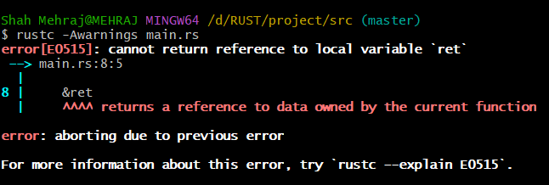
stack memory
fn main(){
let a = 22;
let b = add_1(a);
} fn add_1(i: i32)->i32{
i + 1
}
fn add_1(i: i32)->i32{
let ret = i + 1;
&ret
}
main()
a
22
b
23
sp
sp
sp
add_1()
add_1()
i
22
i
22
ret address
0x12f
ret address
0x12f
sp

Slide 7
Heap memory
Unlike stack, heap is not per thread, all threads of a process share a common heap.
Allocated at runtime, slower in speed.
Memory manager requests the OS for more memory using a system call after heap is filled.
Memory manager uses malloc() provided by C for memory allocation.
Memory allocator requests memory in chunks to reduce the number of system calls.
To reduce the intervention of OS, freed memory is not immediately returned to OS.
Memory allocator keeps track of memory pages(used / freed).
Fight with borrow checker.
Assignee is moved and invalidated and assigned container is made the new owner
String Objects, Vectors, Box, Rc, Arc.

Slide 8
02
Dynamic Memory Allocation
Accessing memory on heap

Slide 9
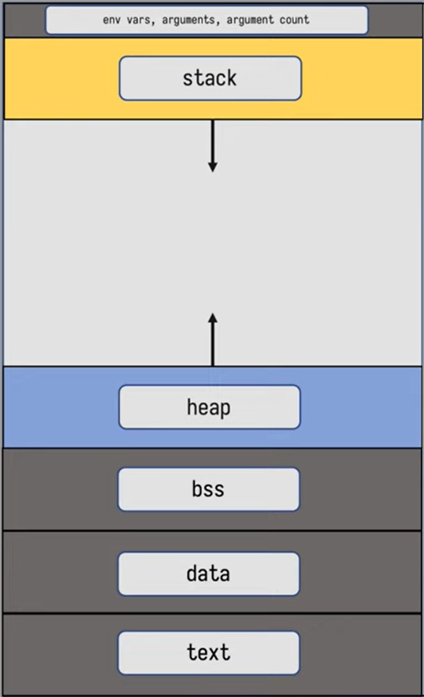
Memory Layout
Text segment (read only) contains instruction of a program.
Data segment includes variables with defined values before the execution of program.
BSS contains zero or NULL initialized global variables.
Stack stores local variables, function call information, and managing function calls and returns.
Heap is mostly used for offline memory.

Slide 10
dynamic memory allocation
Allocate memory at runtime.
Slower in speed.
Fight with borrow checker.
Assignee is moved and invalidated.
Assigned container is made the new owner.
Resides on heap.
String Objects, Vectors, Box, Rc, Arc.

Slide 11
strings
UTF-8 encoded.
String literals are immutable.
String objects can be mutable.
String objects are heap allocated.
len() method returns number of bytes, not the number of characters.
Cannot be indexed using [].
struct String {
data: *mut u8,
len: usize,
cap: usize
}

Slide 12
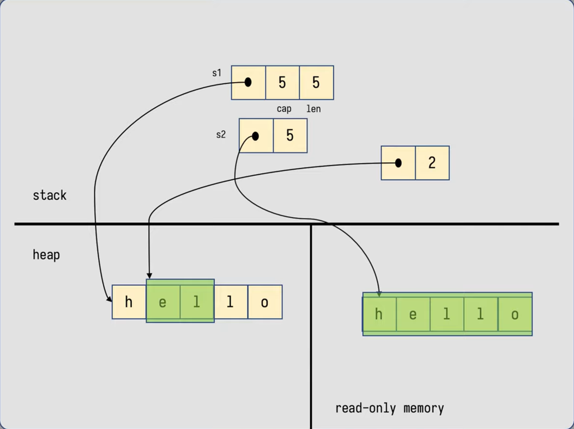
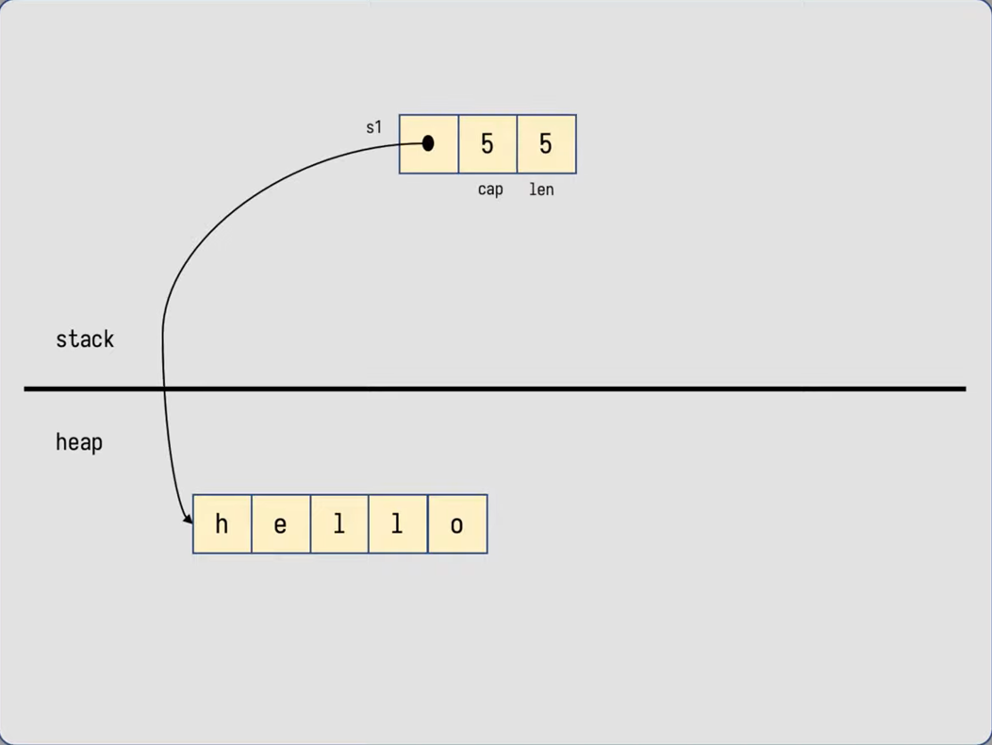
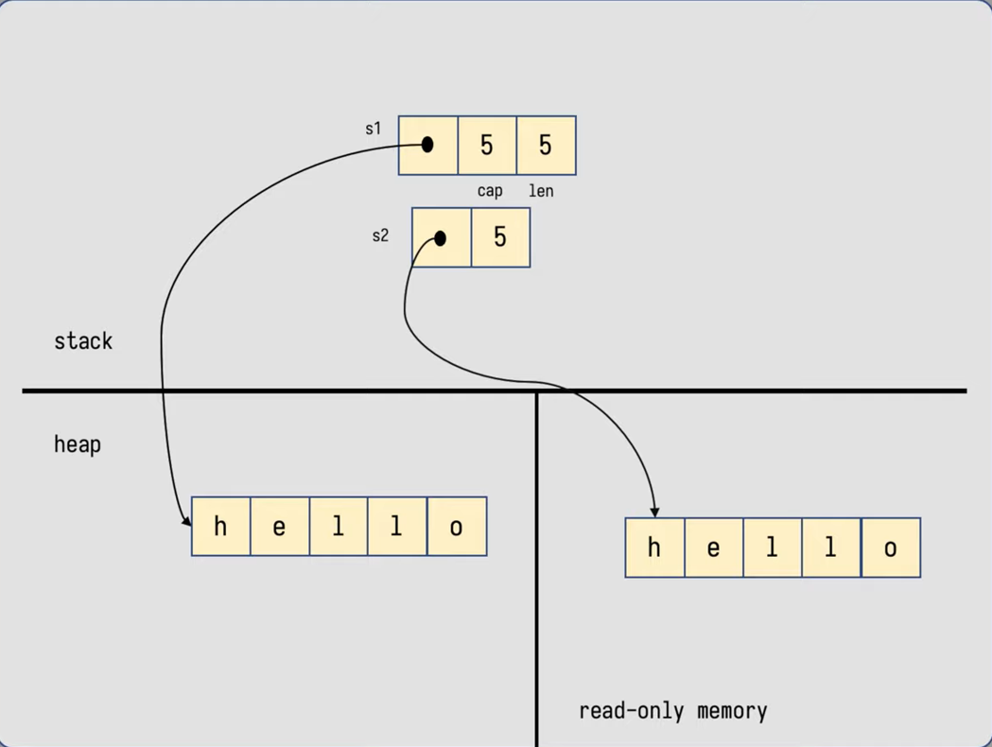
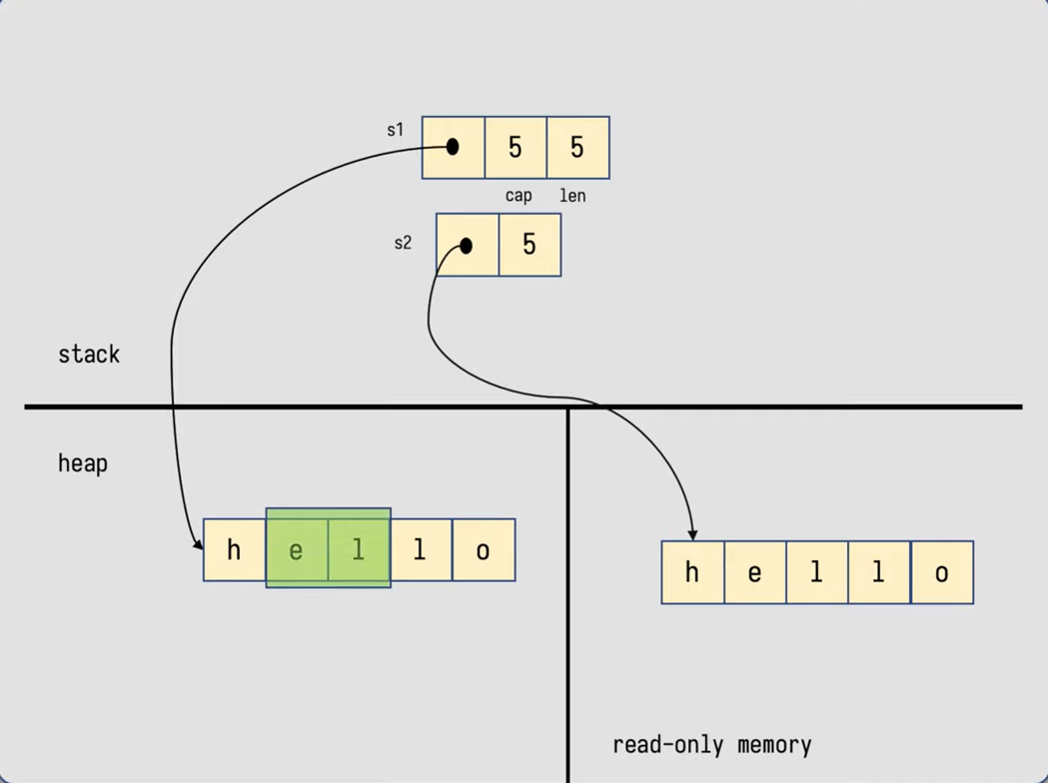
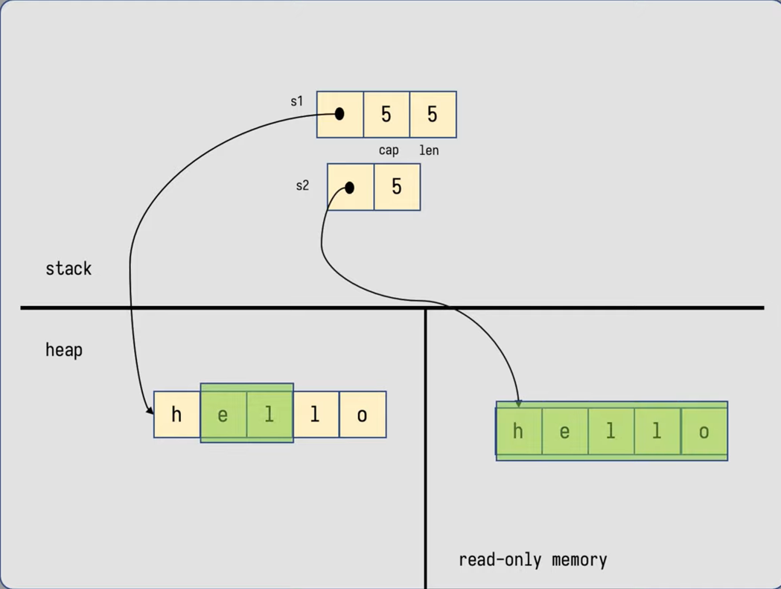
..Strings
fn main(){
let s2 = "hello";
let s1 = s2.to_owned();
let s= &s1[1..3];
println!("{}", s);
}

Slide 13
vectors
Use shrink_to_fit() if memory optimization is priority!
Resizable arrays.
Accessing invalid indices caught during compile time.
Metadata stored on stack.
Traversed using loop or debug trait.
Resizing is costly.

Slide 14
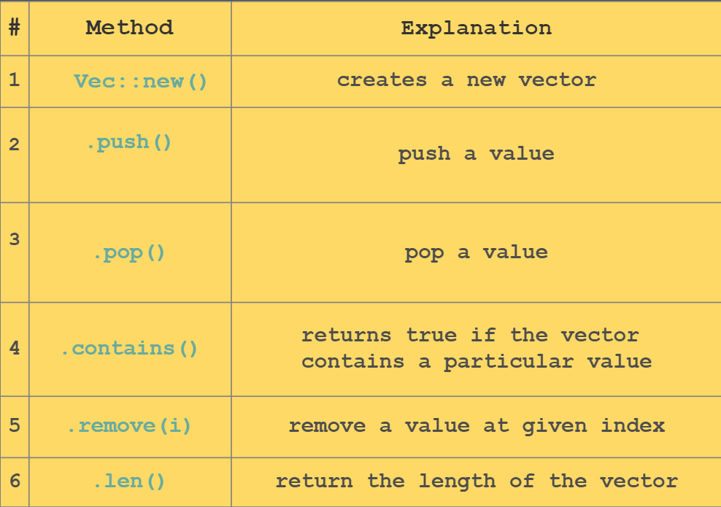
..vectors
Use get(index)to check if index is valid!

Slide 15
smart pointers
Use Case
Data structures that act like a pointer.
Have additional metadata and capabilities.
Automatic memory management, overloaded operators, and destructors.
implement the Deref and Drop traits.
Have ownership capabilities.
Box<T>, Rc<T>, Ref<t>
use std::rc::Rc;
fn main() {
let x = Rc::new(5);
let y = Rc::clone(&x);
println!("x = {}", x);
println!("y = {}", y);
std::mem::drop(x);
//println!("x = {}", x);
println!("y = {}", y);
}

Slide 16
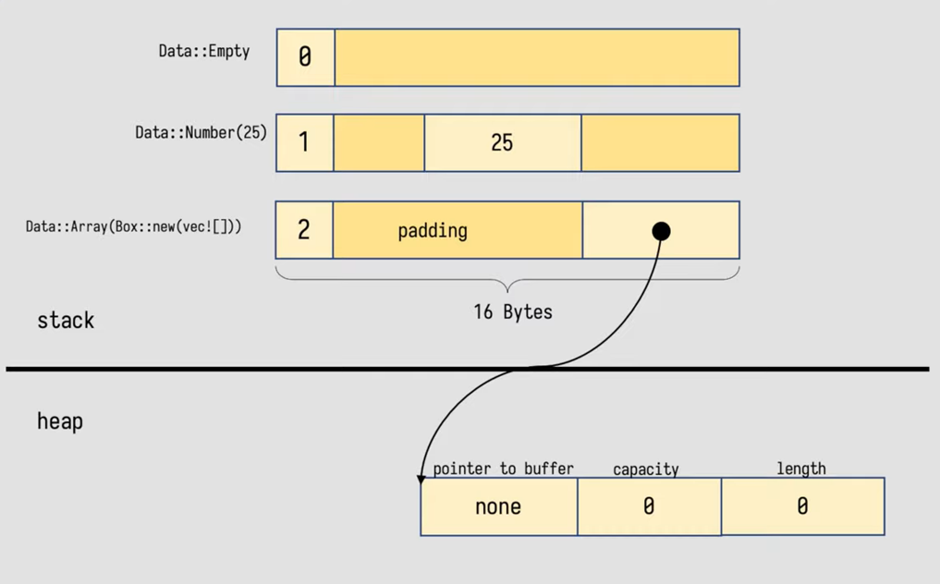
Box pointer
enum Data {
Empty,
Number(i32),
Array(Box<Vec<i32>>),
}
use Data::*;
fn main() {
let d1 = Empty;
let d2 = Number(42);
let a = vec![1, 2, 3];
let d3 = Array(Box::new(a));
match d3 {
Empty => print!(“Empty"),
Number(n) => print!("{}",n),
Array(a) => print!("{:?}",a),
}
}

Slide 17
ref. counting pointer
Multiple ownership of a value on the heap.
Non-atomic reference counting, not thread safe.
Share value between multiple functions without copying.
Keeps track of the number of references to a value.
Drops the value when there are no more references.
Cannot detect cycles, use weak pointers to beak cycles.
Implements the Deref trait.

Slide 18
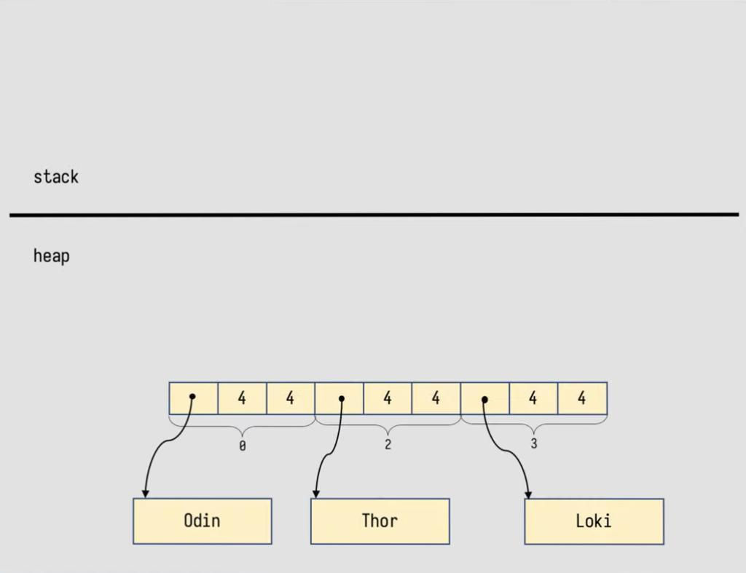
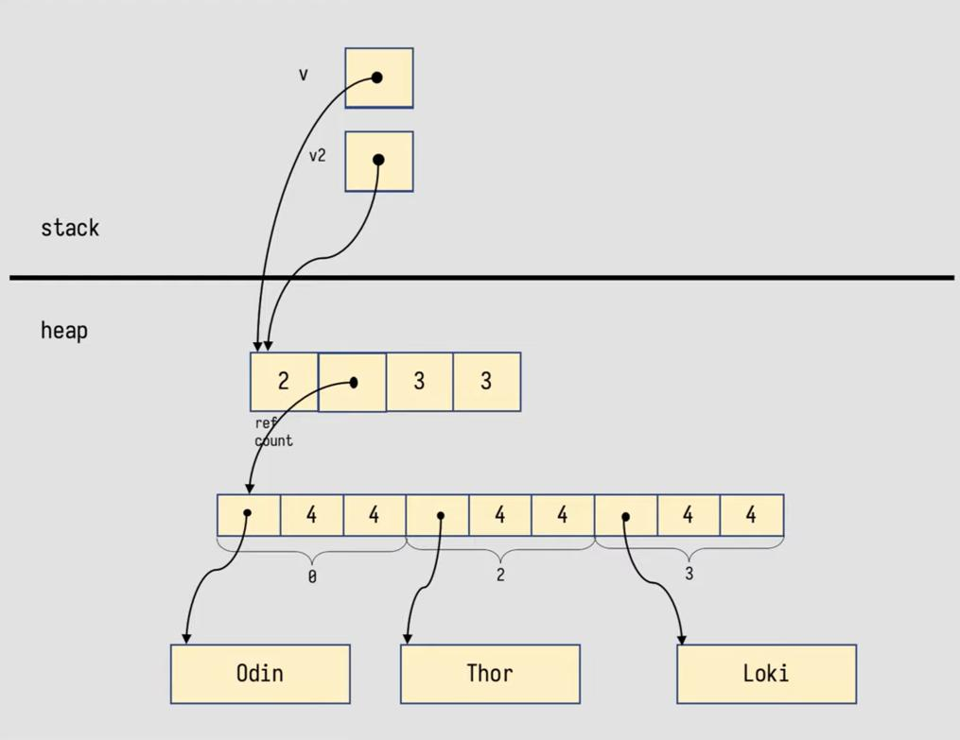
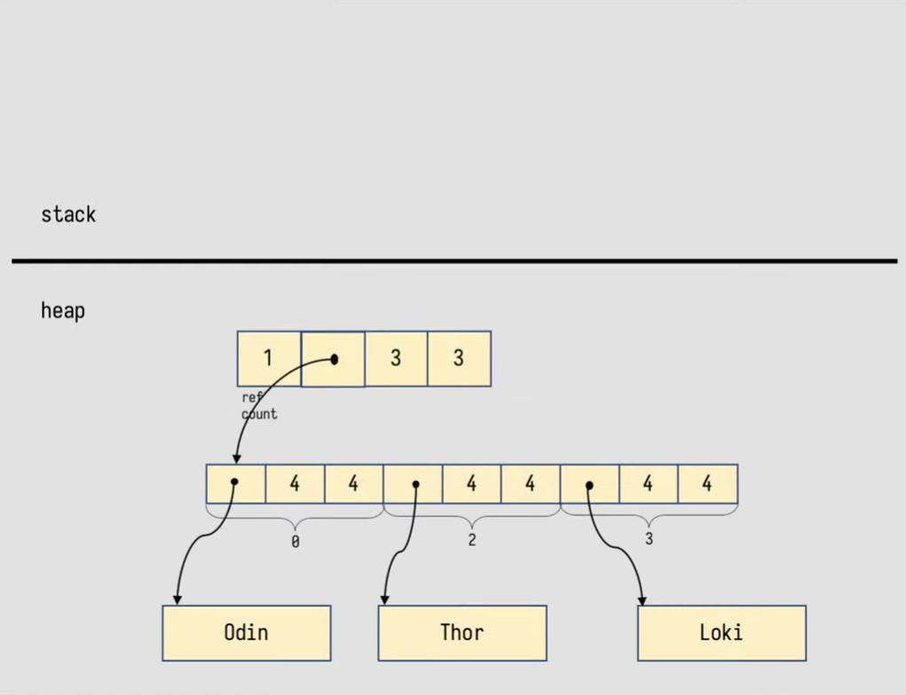
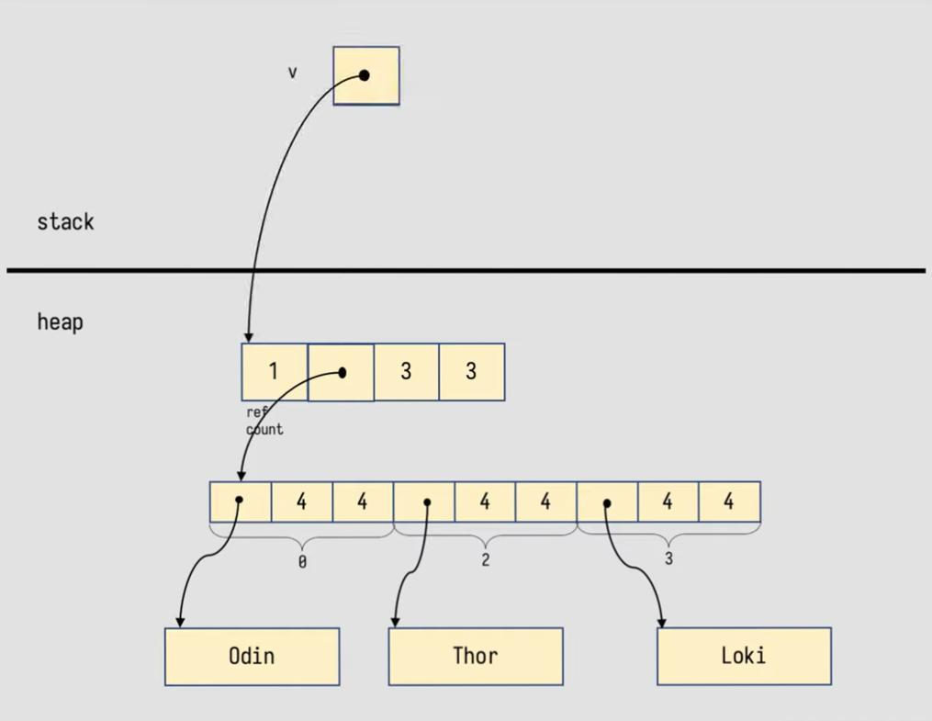
ref. counting pointer
fn main(){
let v = Rc::new(vec![
"Odin".to_string(),
"Thor".to_string(),
"Loki".to_string() ]);
let v2 = v.clone();
print!("{:?}{:?}",v,v2);
std::mem::drop(v);
print!("\n{:?}", v2);
}

Slide 19
Thanks!
Do you have any questions?
youremail@freepik.com
+34 654 321 432
yourwebsite.com
Please keep this slide for attribution

